Slide 1




MaPa
MaPa
MaPa

Slide 2
Noa Simon
Algorithm Engineer
Deep Learning
M.Sc. Computational Neuroscience
Notes:
Hi, my name is noa
I have Msc in computational neuroscience, on my day job I’m an algorithm engineer developing machine learning solutions of artificial deep neural networks
And in my night job, I’m a mother for 2

Slide 3
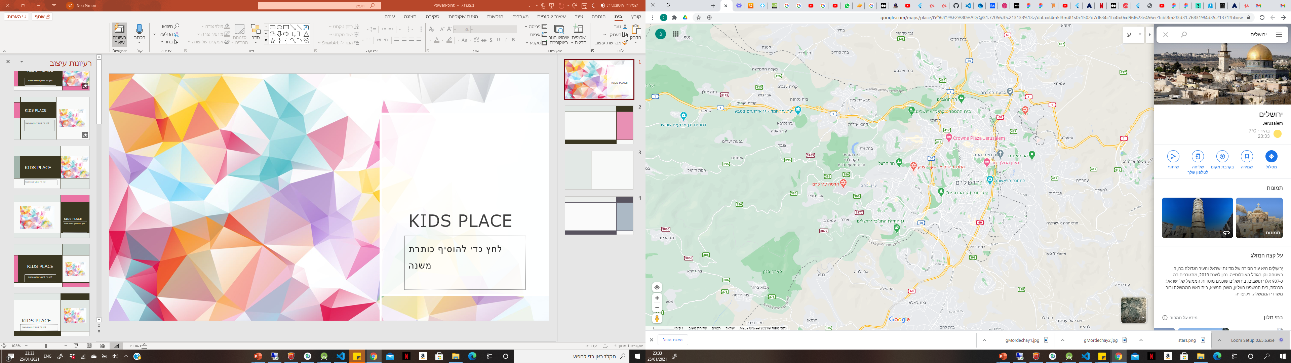


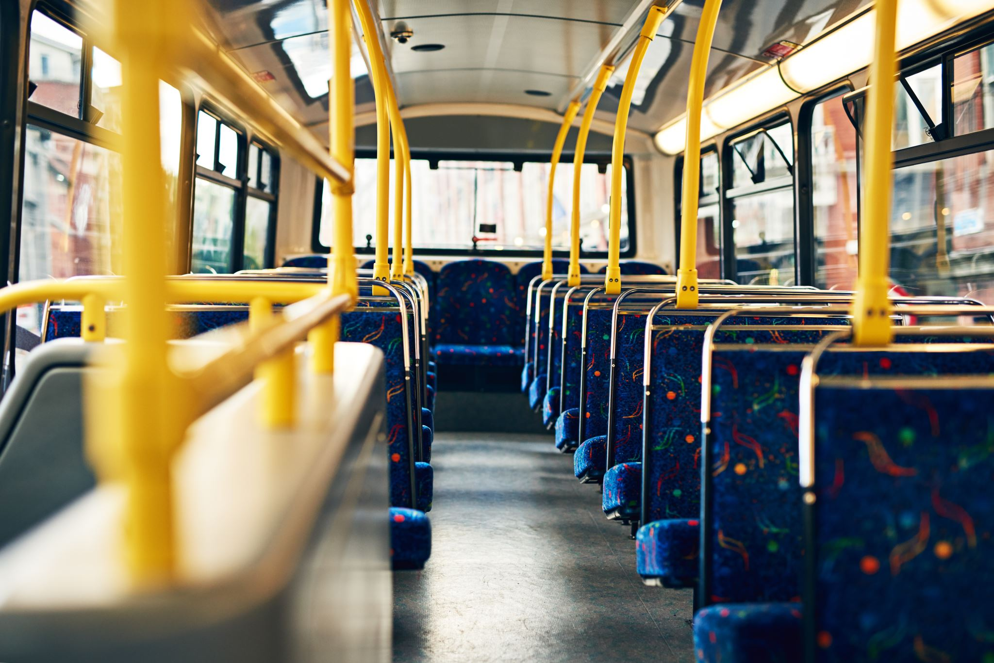
Notes:
and I live in Jerusalem in the same area few years,
And I thought I know everything here-
What are the best coffee shops, who are the recomended doctors in different domains, and know the public transportation as the palm of my hand

Slide 4
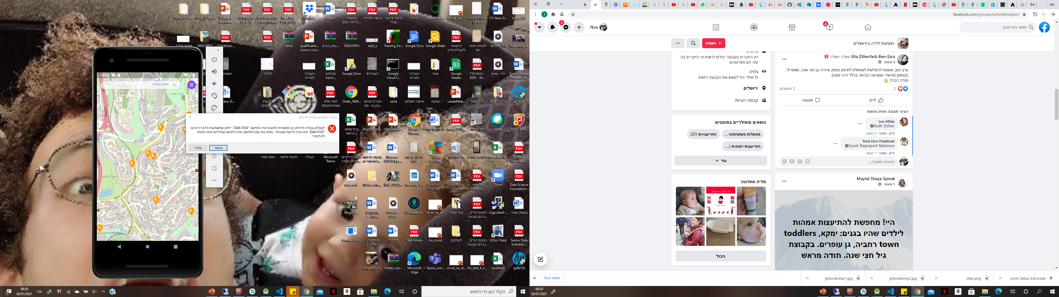
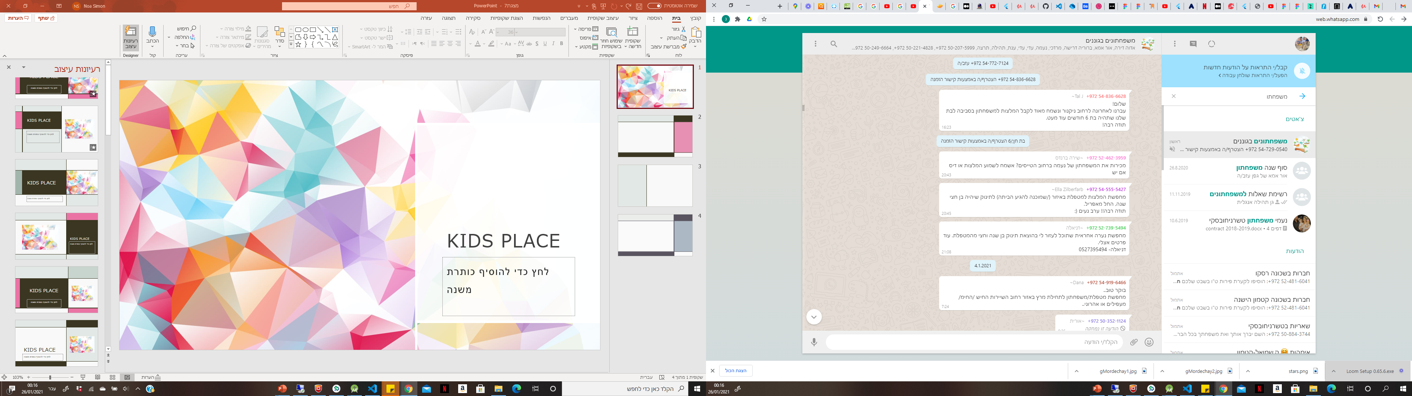
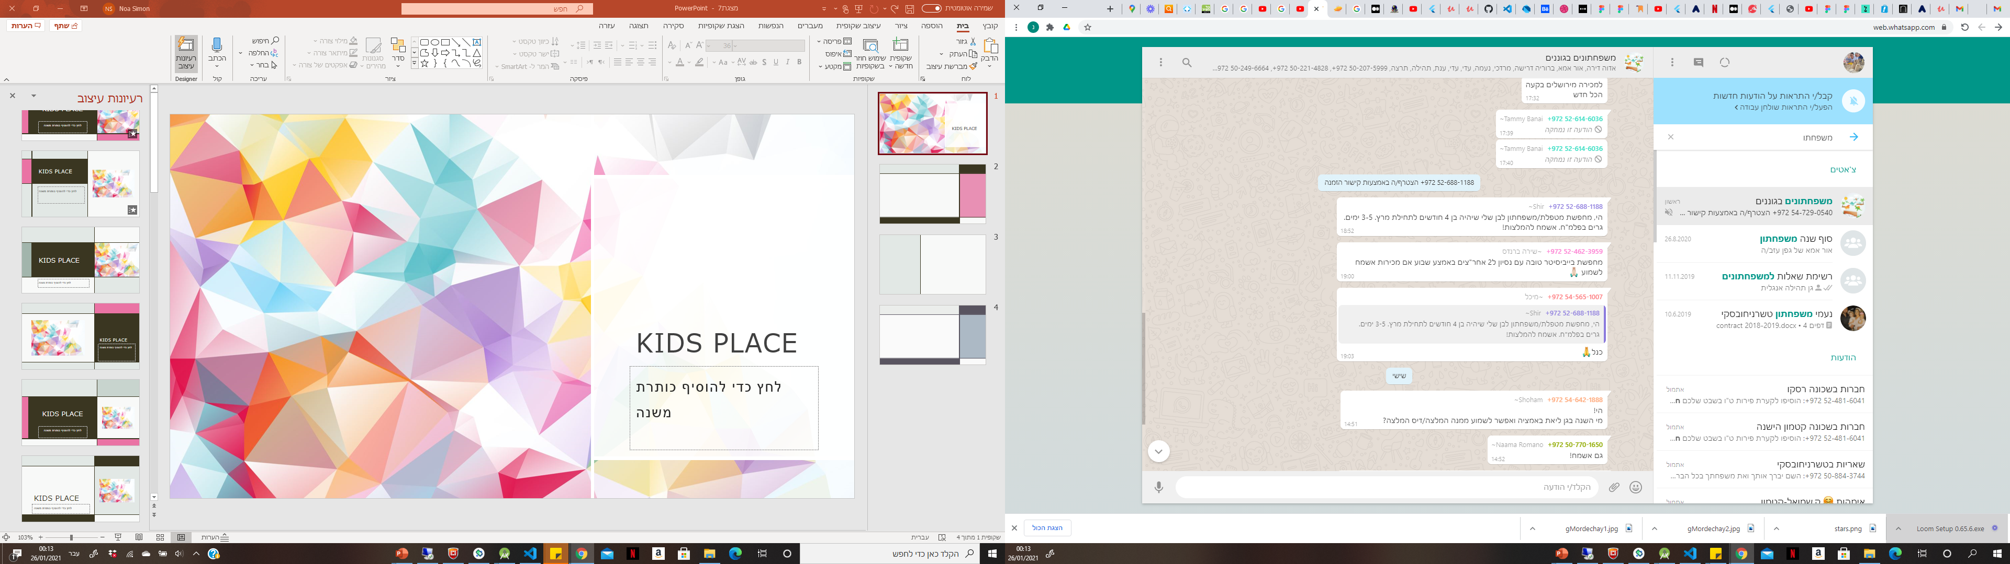

Notes:
Not long ago I became a mom and discovered that I don’t know anything
Don’t know what are the kindergartens around me,
Where are the playgrounds and who is the recommended pediatrician
I looked in facebook and wahtsapp groups and found a lot of information on few places, not up-to-date information or none at all on a lot of other places and mainly more questions than answers

Slide 5
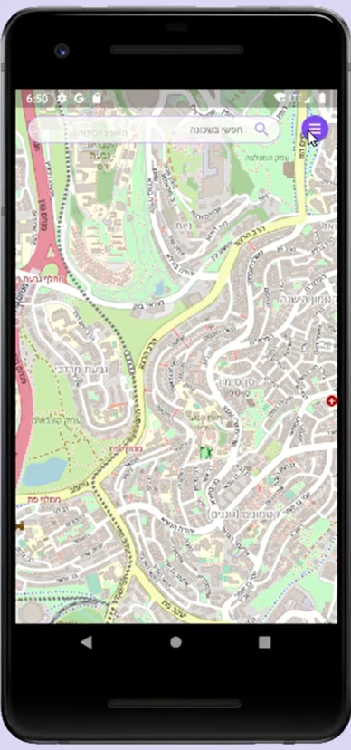
MaPa
All the knowledge a family needs
Education, Health, Fun...
Recommendations
Notes:
So I thought about a solution- MaPa
application that will gather all the knowledge a parent needs- education, health, fun and more, and mainly most important – recommendations of parents, exactly like us but with a little more experience.
You can see here the app I developed
the categories- kindergartens, babysitters, consultants, events, etc
When you enter the app you can insert the children’s ages and the app will automatically filter everything accordingly.
Here for a very young child- in the kindergartens- relevant age, up to 12 children and no more than 4 children for 1 caregiver, of course you can change whatever you want.
In the playgrounds it is also filtered for the same age, you can see all the playgrounds with small slide and safety swing, we can go back and change if we want to see only playgrounds with the relevant swings, and now you see that there are fewer playgrounds here
This one looks promising – and here are details and pictures

Slide 6

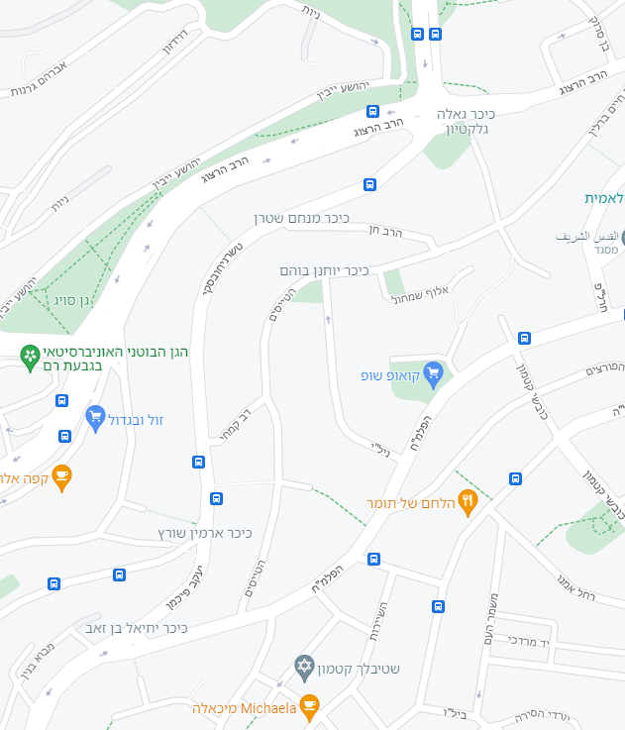
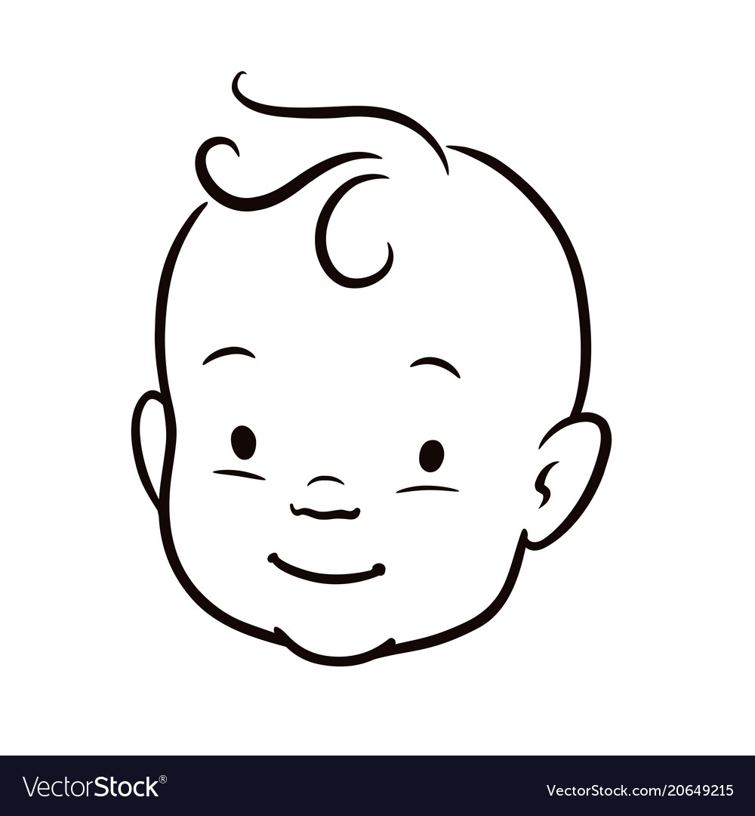
Between one child and the village it takes to raise him...
Private:
Information
Pictures
Memos
Neighborhood:
Kindergartens
Playgrounds
Events
Babysitters
Secondhand
Notes:
The app moves between private and general areas
In the private area you can store pictures of your baby, important information, etc.
In the neighborhood area as we saw- kindergartens and playgrounds, also babysitters, events, secondhand children’s clothes / equipment and more
It will also be a social network where you can see avatars of your friends at one playground and decide to go there instead of other
That way we will restore the community, the tribe we use to grow children to, the village it takes to raise a child

Slide 7
Between one child and the village it takes to raise him...
Neighborhood:
Kindergartens
Playgrounds
Events
Babysitters
Secondhand

Slide 8
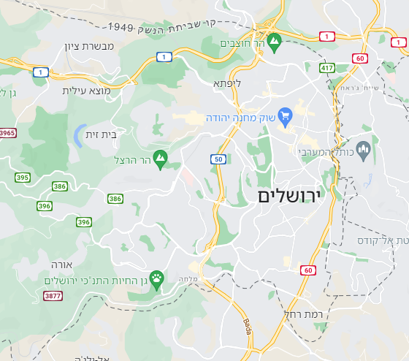
Between one child and the village it takes to raise him...
City:
Doctors
Consultants (sleeping, breastfeeding)
Shops
Notes:
Zooming out to city wide – doctors, consultants, shops, etc.
Of course it is flexible and depend on personal preferences between the closest or the best

Slide 9
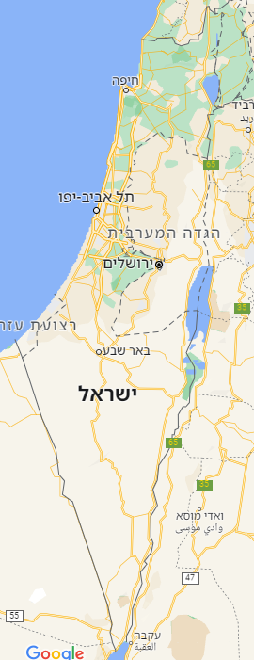
Between one child and the village it takes to raise him...
country:
Forums for:
health
Activities
And more
Notes:
And countrywide- forums for ideas and consultations in different domains

Slide 10

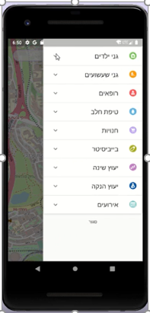

Business Model
Notes:
How will it make money?
B2B
When a parent reachs a business through the app, (sleep consultant for example)
The business will pay a commission for the lead
For the business it will be a place with targeted specific customers, both geographic and their interest

Slide 11


Thank you!
MaPa
noasimon88@gmail.com
050-6998958

